Slide 1
WELCOME
FALL 2022
(This presentation is an adaption from the 8/16/22 New Graduate Assistant Orientation)

Slide 2
Thank You!
We’re glad you’re here!
Dr. Suzanne Bausch
VP of Research & Business Engagement and
Dean, Graduate School
Dr. Marnie Saunders
Interim Director, the Graduate School
Professor, Dept. of Biomedical Engineering
Deborah Phillipp
Dir., Graduate Admissions & Student Services

Slide 3
AGENDA TOPICS
New Graduate Assistant Orientation
Graduate School Overview
Resources & Events
  Teaching in the classroom
  Health Services
  Testing & Counseling
  Parking & Transportation
  Financial Aid
  Getting Involved
  ZipAssist
GA Guidelines & Expectations
  Student Code of Conduct and Title IX
  Eligibility
  Payroll

Slide 4
AGENDA TOPICS
New Graduate Assistant Orientation
Graduate School Overview
  Where
  Who
  What

Slide 5
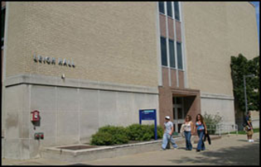



Graduate school overview
Office Location
The Graduate School
Leigh Hall, Room 515
Akron, OH 44325-2101
330-972-7663
330-972-6475
gradsch@uakron.edu

Slide 6
Graduate school overview
Staff
Ms. Heather Blake – Curriculum Support
Ms. Vivian Campbell – GA Contracts
Ms. Deborah Phillipp – Admissions, Graduation

Slide 7
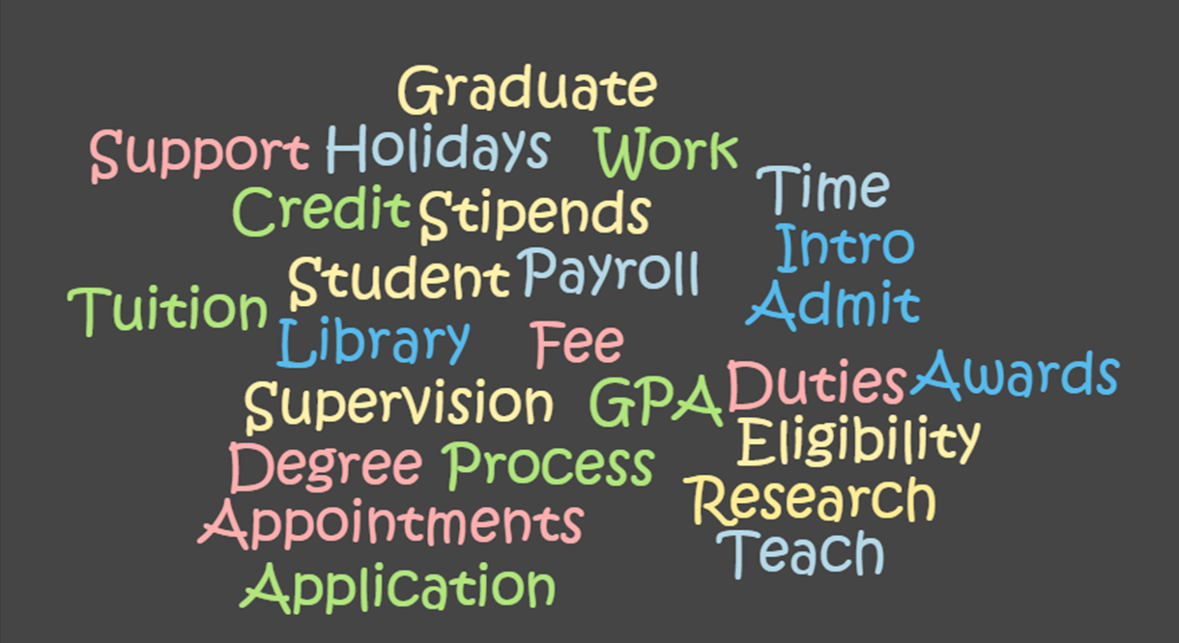
G.A. Guidelines & Expectations
The Graduate Assistant Handbook
www.uakron.edu/dotAsset/678001.pdf

Slide 8
AGENDA TOPICS
New Graduate Assistant Orientation
G.A. Guidelines & Expectations
  Eligibility
  Fee remission
  Research

Slide 9
G.A. Guidelines & Expectations
Eligibility for a Graduate Assistantship
Full Admission to a Graduate Program
You must be enrolled as a full-time student during each semester you are working as a graduate assistant.
Full-time definition
  Fall and Spring – minimum of 9 hours
  Summer – minimum of 6 hours
Maintain a minimum cumulative 3.0 GPA and progressing toward degree completion
Maximum work hours may not exceed 20 hours/per week
  Students may not hold additional employment if on a full-time assistantship

Slide 10
G.A. Guidelines & Expectations
Maintaining a Graduate Assistantship
You are required to perform your graduate assistantship duties satisfactorily
You must maintain the standards of academic conduct
You must honor the terms of your contract agreement
If a TA – you must meet the minimum oral proficiency requirement
  23 – TOEFL Speaking Component (Internationals)
  Assessed by departmental procedures (Domestics)
If you give up your assistantship – you also give up the tuition waiver – repayment is required (after Census date)

Slide 11
G.A. Guidelines & Expectations
FEE REMISSION FOR GRADUATE ASSISTANTS (GAs)
UA shall provide a scholarship during each semester or summer session of award.
Scholarships are not provided for:
undergraduate/audit courses
professional fees
administrative fees
facilities fees
technology fees
drop/add fees
library fees
miscellaneous fees
general service fees
late registration fees
tuition/fees at other institutions

Slide 12

G.A. Guidelines & Expectations
OFFICE OF RESEARCH ADMINISTRATION
https://www.uakron.edu/research/ora/

Slide 13
AGENDA TOPICS
New Graduate Assistant Orientation
G.A. Guidelines & Expectations
  Title IX and
  Student Code of
  Conduct

Slide 14
AGENDA TOPICS
New Graduate Assistant Orientation
G.A. Guidelines & Expectations
  Teaching at UA:
  The Institute of Teaching and Learning

Slide 15
AGENDA TOPICS
New Graduate Assistant Orientation
Resources
  Financial
  Aid

Slide 16
AGENDA TOPICS
New Graduate Assistant Orientation
Resources
  Testing &
  Counseling

Slide 17
AGENDA TOPICS
New Graduate Assistant Orientation
Resources
  Zip Assist

Slide 18
AGENDA TOPICS
New Graduate Assistant Orientation
Resources
  Payroll

Slide 19
G.A. Guidelines & Expectations
PAYROLL INFORMATION
Payroll forms
International students: e-mail Brenda McHenry at mchenry@uakron.edu
2022 W-4 Form
Ohio IT-4 Form
Non-Resident Alien Identification Form
Form SSA-1945
Direct Deposit Form (pick-up 1st paycheck)

Slide 20
G.A. Guidelines & Expectations
PAYROLL INFORMATION
State Retirement
OPERS Exemption Form or Election Form for Students
  (Hired on or after September 28, 2016)
SERS Exemption Form or Membership Record
Students are eligible to be exempt from state retirement membership while regularly attending classes. Before you sign a student exemption, consider that the service credit you earn while in college counts toward your retirement if you become employed in the public sector during your career.
30 days from date of hire to submit an exemption form
(August 22 start must submit by September 20)
Forms available on the Payroll Forms web page: https://www.uakron.edu/controller/payroll-forms.dot

Slide 21
G.A. Guidelines & Expectations
If you are an active member in State Teachers Retirement System of Ohio (STRS) and you are not on a leave of absence from a teaching position covered by STRS Ohio, you may apply for exemption from contributions to STRS Ohio.
Please consult the STRS Ohio website at https://www.strsoh.org/employer/reporting/determination/exemptions.html
for more information and an “Exemption from Contributions for Student Employees” application form.
If you are an active member in State Teachers Retirement System of Ohio (STRS) and on a leave of absence from a teaching position covered by STRS Ohio, or wish to contribute to STRS Ohio, you must complete a “Member Information” form.
The form is available on the STRS Ohio website at
https://www.strsoh.org/employer/reporting/new-hire/overview.html.

Slide 22

Biweekly payroll schedule
https://www.uakron.edu/controller/payroll.dot
Submit all Payroll forms to the Payroll Office:
Administrative Services Building (ASB) Room 102
185 East Mill Street, Akron, Ohio 44325
Questions?
Contact | Last Name Begins With | Ext
Sue Allshouse | A – Fe | 6759
Carla Corsaro | Fi – Ln | 6555
Ruth Roberts | Lo – R | 6558
Sandra White | S – Z | 6553
Brenda McHenry | International Students | 2312

Slide 23
AGENDA TOPICS
New Graduate Assistant Orientation
Resources
  Health
  Services

Slide 24
AGENDA TOPICS
New Graduate Assistant Orientation
Resources
  Parking
  &
  Transportation

Slide 25
resources
Parking & Transportation
  Parking permits
  Lot/Deck information
  Shuttle services
  Maps & routes
www.uakron.edu/parking

Slide 26
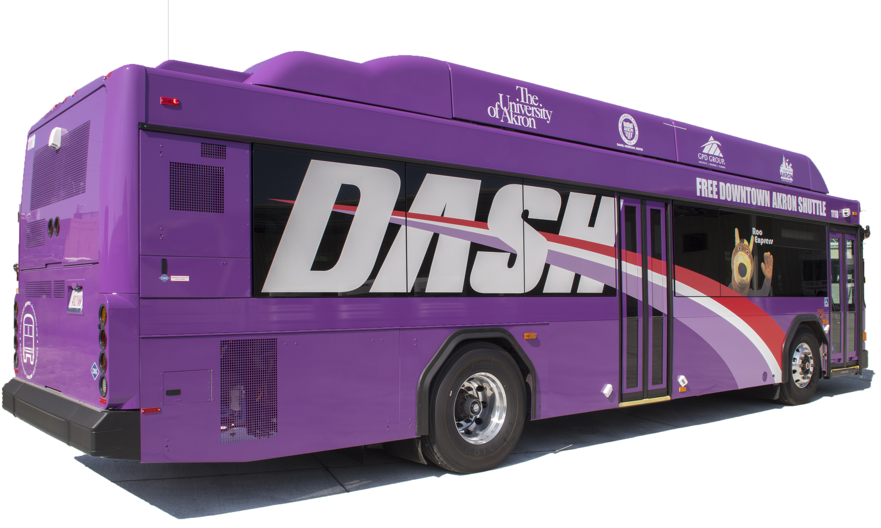
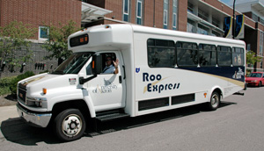

resources
www.uakron.edu/parking

Slide 27
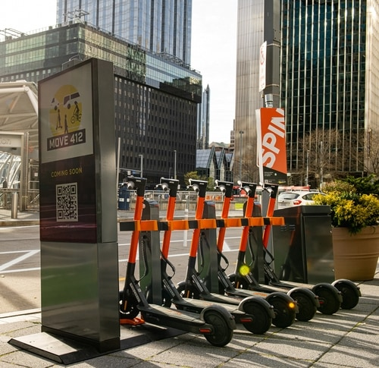
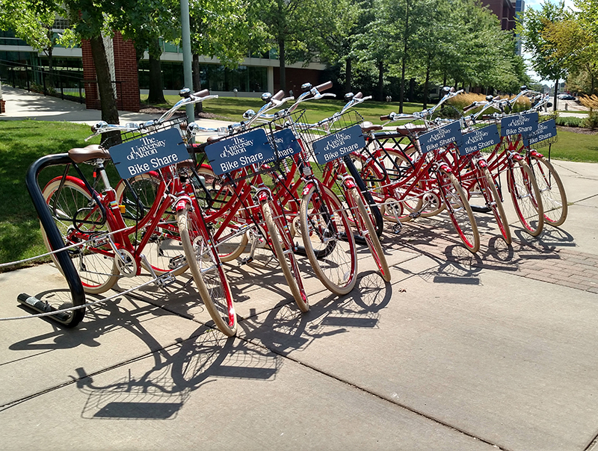
resources
Bike Share
www.uakron.edu/bikeshare
Scooters

Slide 28

resources

Slide 29
AGENDA TOPICS
New Graduate Assistant Orientation
Events / Things to do
  Get
  Involved

Slide 30
Events
Spring Semester
Graduate Student Appreciation Week
April 4 – 10, 2023
Professional development and fun activities
More details to come…

Slide 31

Events each Semester
Writing your Thesis or Dissertation
Plagiarism
References
Citations
Literature
Formatting
Workshop dates T.B.A.

Slide 32

Events each Semester
www.uakron.edu/exl/

Slide 33

Events get involved!

